Slide 1
Get Started with Power Automate for Desktop

Slide 2
Power Automate for Desktop Development Essentials

Slide 3
Introduction
Power Automate for desktop
An RPA software solution capable of automating rules-based tasks, enabling users to direct their attention to more productive and value-adding tasks.
In this module, you will:
Create a flow from scratch using the flow designer
Learn how to use actions and variables
Understand the testing and debugging features of the flow designer
Configure the error handling properties of individual actions
Comprehend the use of UI elements and images
Use subflows to compartmentalize and reuse parts of a flow
Notes:
Prerequisites
Basic familiarity with the Power Automate for desktop console

Slide 4
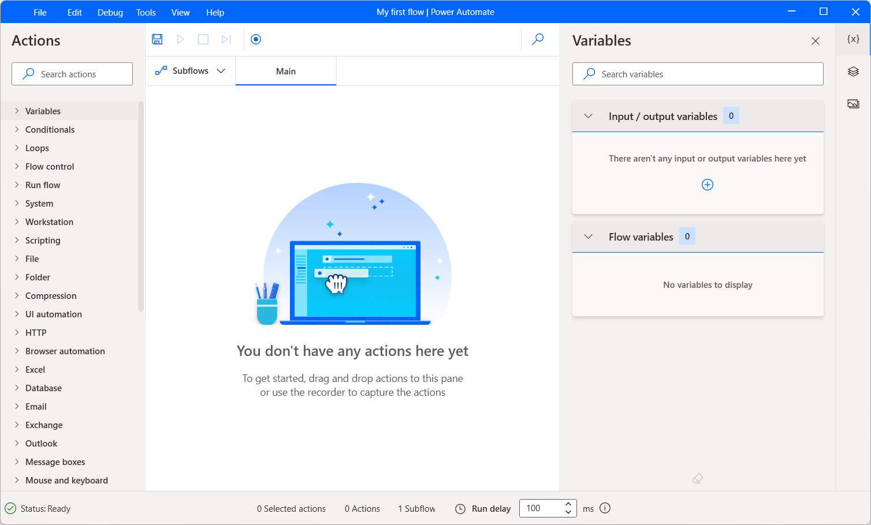
Create a flow in the flow designer
Create a new flow
The flow designer is where all flows are built, edited, and tested.
Actions
Actions are the basic building blocks of a flow; flows are essentially series of actions, which are run sequentially.
Variables
Variables are data containers that Power Automate for desktop uses to store data for later use.
Notes:
The creation of a flow takes place in the Power Automate for desktop console. On the top-left, press the New flow button to create a new flow.
Enter the name of your new flow and select Create; this will open the flow designer window.
To add an action to the flow, drag & drop it from the actions pane to the main workspace pane, or double-click on it. The actions pane is located by default on the left-hand side of the flow designer.
When added, the action’s properties window automatically appears, allowing the user to configure the action’s details.
Variables are contained between percentage marks, which allows them to stand out from simple text.
Variables can be produced as output from actions, or used as input for other actions. Opening an Excel worksheet, for example, produces a variable containing the Excel instance. This variable may then be used as input in any following actions that require interaction with that particular Excel instance:

Slide 5
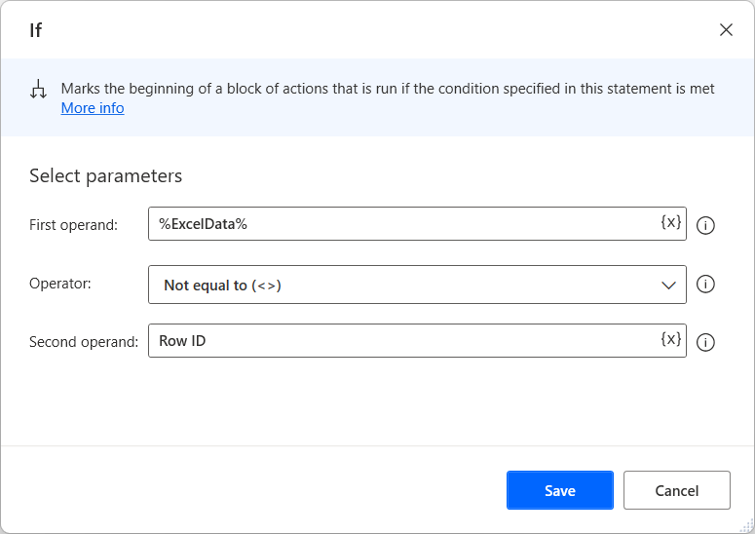
Create conditionals and loops (1/2)
Conditionals
Conditional actions allow flows to modify their behavior during runtime, based on the data available at the time.
Essentially, they allow flows to make choices based on the information at their disposal.
Notes:
As mentioned before, actions within a flow are run sequentially. However, there are certain actions that may alter this sequence, to achieve greater flexibility and adaptability while running a flow.
In this unit, we will examine two main categories of such actions: Conditionals and Loops.

Slide 6
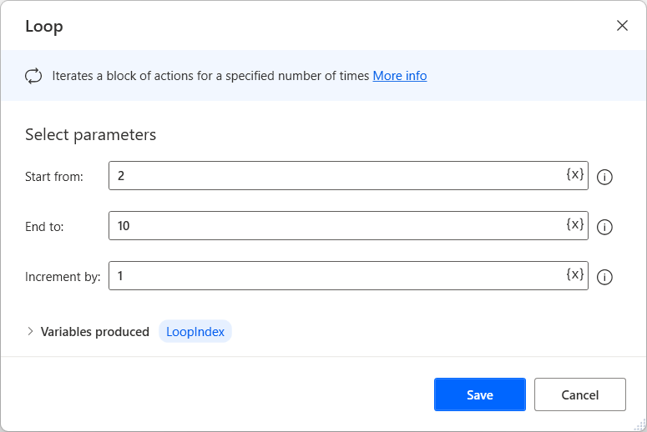
Create conditionals and loops (2/2)
Loops
Loops enable flow to repeat a block of actions multiple times.
The number of repetitions is determined by the type of loop action used and its configuration.

Slide 7
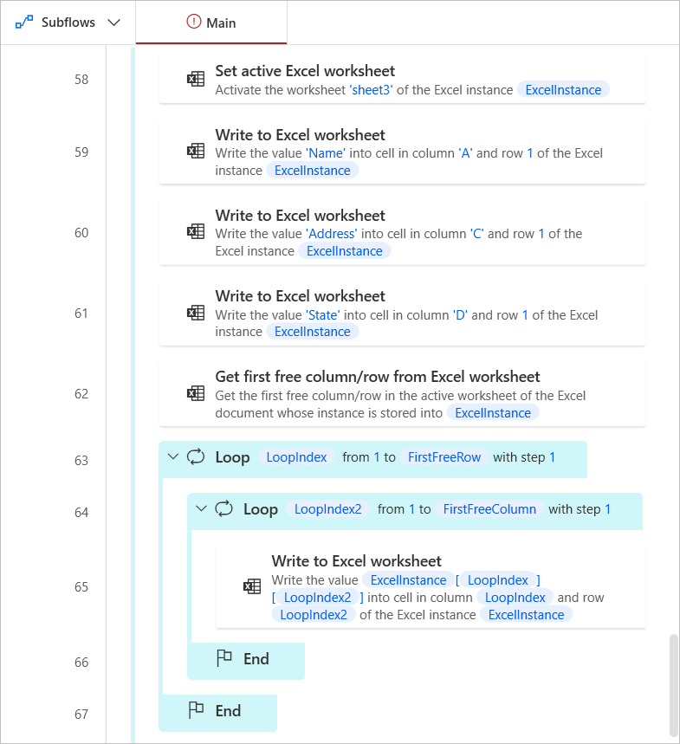
Using subflows
When a flow contains a large number of actions, it may be split up into subflows, making it more manageable and easier to maintain.
Subflows can be used to organize a flow's actions, but they also allow the reuse of parts of the flow, which helps to avoid cluttering by copy-pasted actions.
Notes:
Let’s improve this flow‘s readability without changing its functionality, using subflows to break it up into self-contained parts. This can be done through the subflows list on the top-left.
The Main subflow is always present, since it signifies the start of the flow; we will add more subflows by pressing the New subflow button.
An empty subflow is created and named. We will proceed to add a few subflows which correspond to discrete parts of the flow.
New subflows are visible as tabs at the top of the workspace.
Now, we can proceed to move actions from the Main subflow into these new ones
Finally, to run the subflows, we must make use of the Run subflow action..

Slide 8
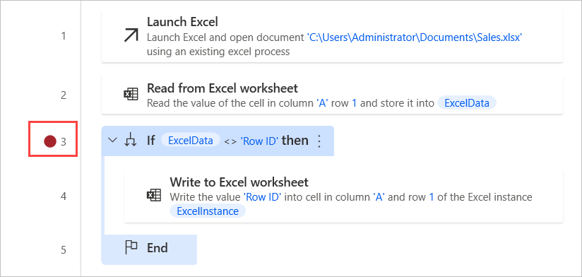
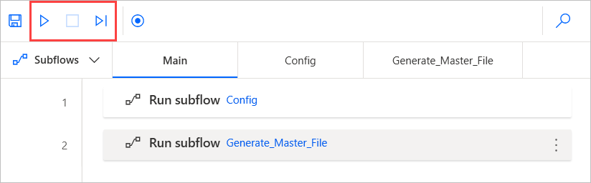
Test and debug flows (1/2)
Testing
Flows under development can be run at any time in the flow designer, through the Run button.
It is possible to run, stop, and resume the flow.
Breakpoints can be added to automatically pause the run when a specific action is reached
Notes:
On the bottom-right corner of the designer, the variables pane contains all the variables used in the flow; information about a variable can be viewed by double-clicking on it. This information is updated in real time, providing users a clear picture of the flow's state at any given time.

Slide 9
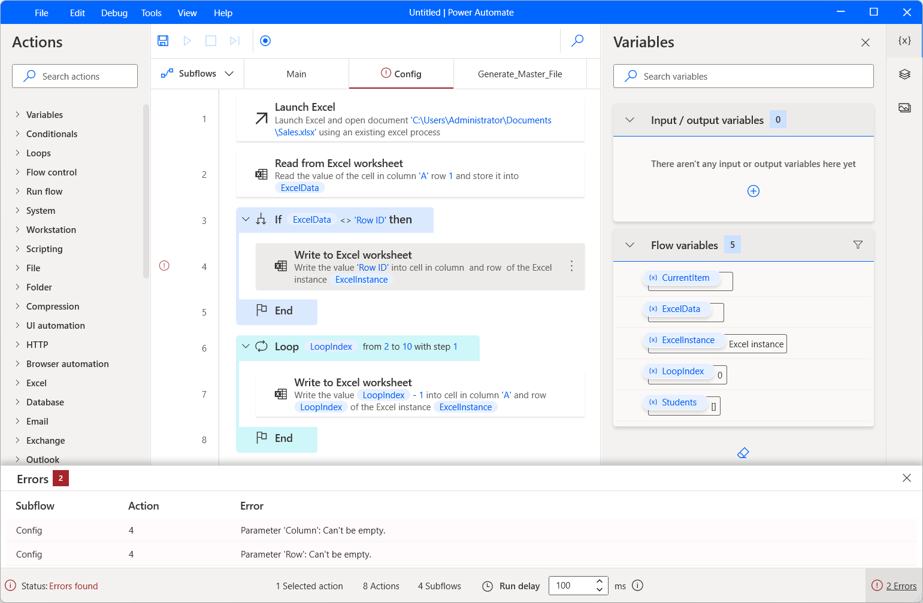
Test and debug flows (2/2)
Debugging
In addition to the above, certain features are designed specifically for locating and correcting errors.
Any design-time errors – errors that are identifiable before the flow is run – are communicated through red symbols in the designer, while details can also be found in the Errors pane at the bottom of the designer.

Slide 10
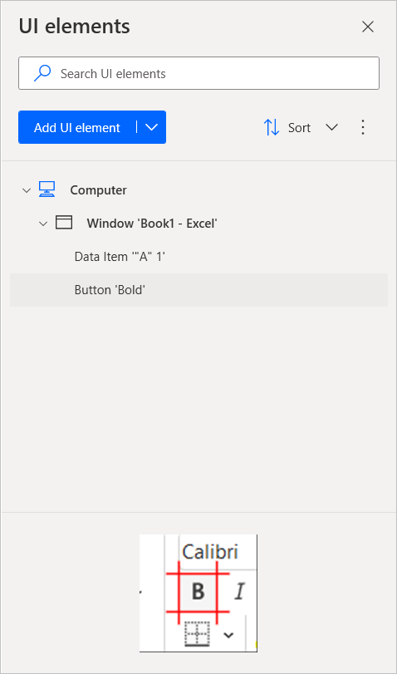
Manage UI elements and images (1/2)
UI elements
UI elements are used by Power Automate for desktop to identify application windows and their components.
Notes:
Automating tasks usually requires interaction with third-party software, application windows, web pages, or other on-screen elements. In order to identify such elements, information about them is stored within a flow – Controls, which are used to interact with UI elements and web pages, and Images, which can be used in image recognition-related actions.
Both are located on the top-right of the designer window; selecting one of the appropriate tabs opens the respective list of elements.
For example, suppose that a flow has to select a cell and make the text inside it bold. To achieve this functionality, you need to extract two UI elements, one for the cell and one for the bold button.
In the UI elements tab, select Add UI element to launch the tool that Power Automate for desktop uses to extract UI elements. When you hover an element with the cursor, it gets automatically highlighted.
Clicking while pressing down the Ctrl button will capture the highlighted element. For this example, you need to capture one UI element for the bold button and one for the cell.
When all the required elements are captured, press Done. The captured elements will be visible in the UI elements pane.
Add two Press button in window actions, and select the UI elements you captured on the previous steps.
After selecting the appropriate UI elements, the actions are configured to press the cell and the button, respectively.

Slide 11
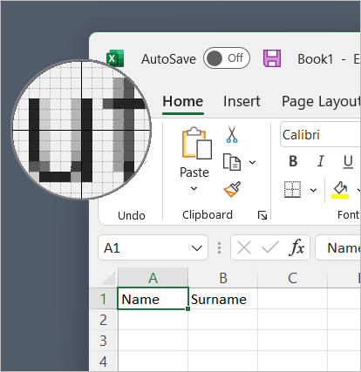
Manage UI elements and images (2/2)
Images
Like UI elements, images can be added to the flow, and used in related actions.
Notes:
When clicking the Capture new image button, the cursor changes, enabling users to select an image to extract in detail:
After the image is given a name, it can be used in image recognition Actions, like Move mouse to image:
Thus configured, the action will search for a matching image on the display, then move the mouse cursor to it.

Slide 12
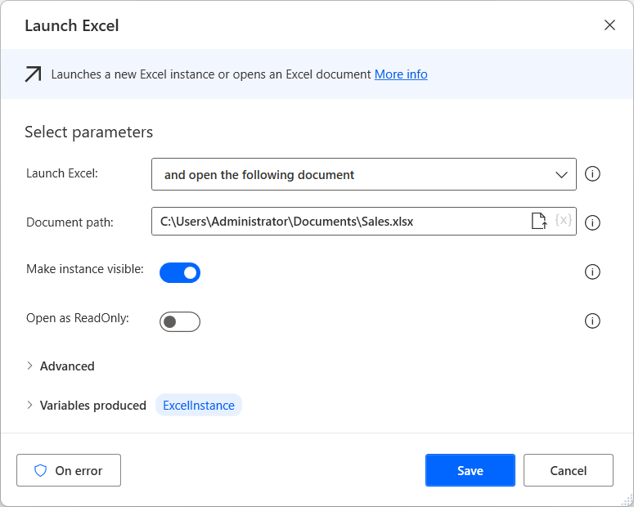
Deploy exception handling
To avoid errors, users may configure exception handling rules, so that the flow can recover and continue running.
Exception handling
Exceptions may occur from virtually any action. For this reason, most actions’ properties contain an On error button.
Notes:
In our example flow, for instance, the Excel file to be processed may not exist in the path specified because it may not have been moved from its initial path to the working one we have entered in the flow. If we know the initial path, we could configure the Launch Excel action so that, if it fails to open the file, it will attempt to open it from its initial path.
To achieve this, we will double-click on the action to edit it
And press the On error button
The selected options will take effect when this action encounters an exception. To open a file in a different path, we will have to create a new subflow that does exactly that
Then configure the previous action’s exception handling accordingly, by pressing New rule and selecting Run subflow
Configured as above, if the Excel file cannot be opened in its usual path, the Alternative Path subflow will run, opening the file in its alternative path; then, the flow will resume running

